Slide 1
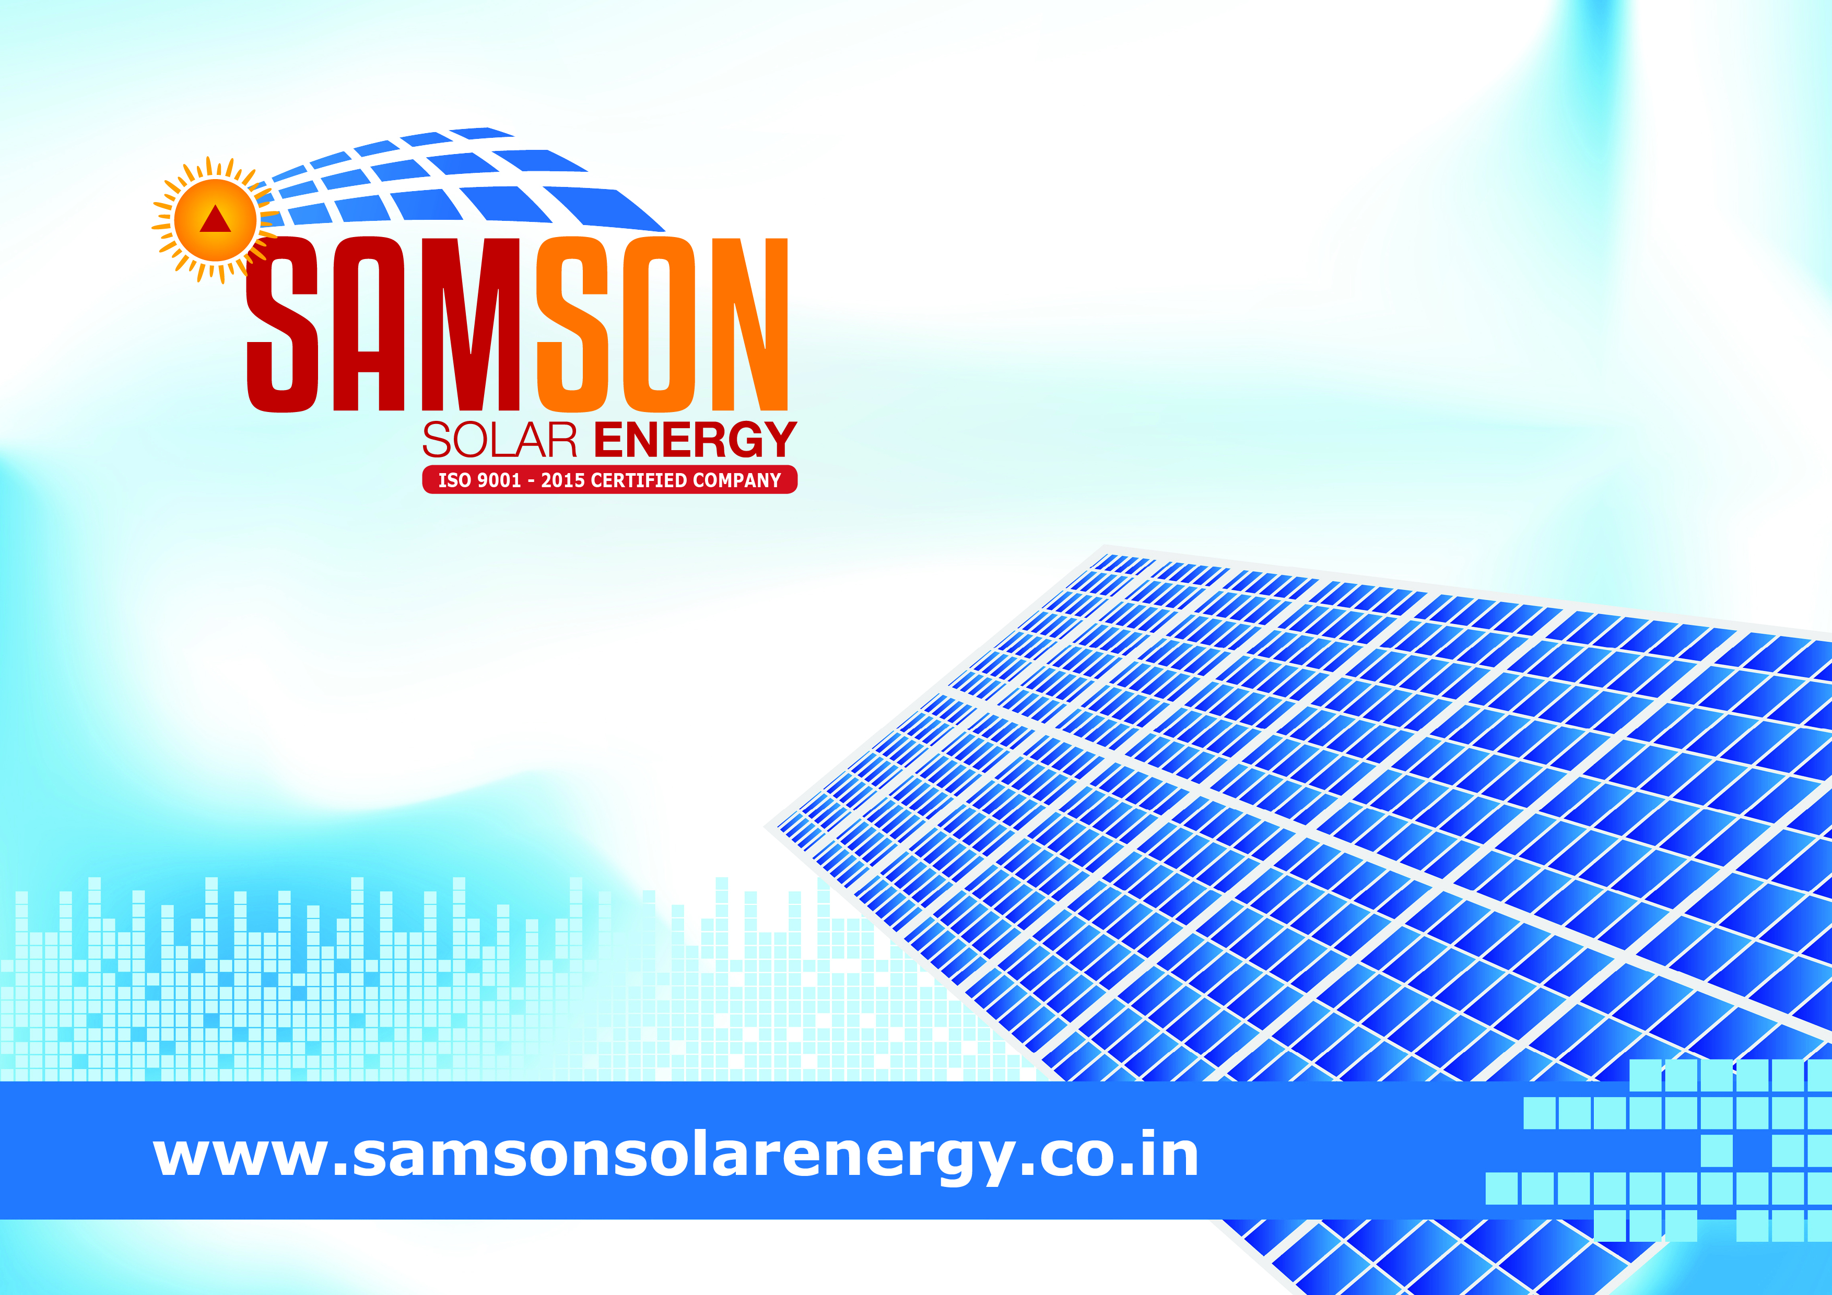



Slide 2


Slide 3

Solar Water Heater
SAMSON Solar Products
Solar Rooftop
Solar Off grid Inverters & Batteries
Solar Street Lights
Solar Water Pumps

Slide 4
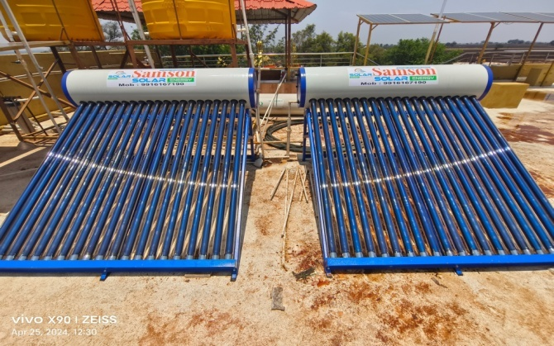
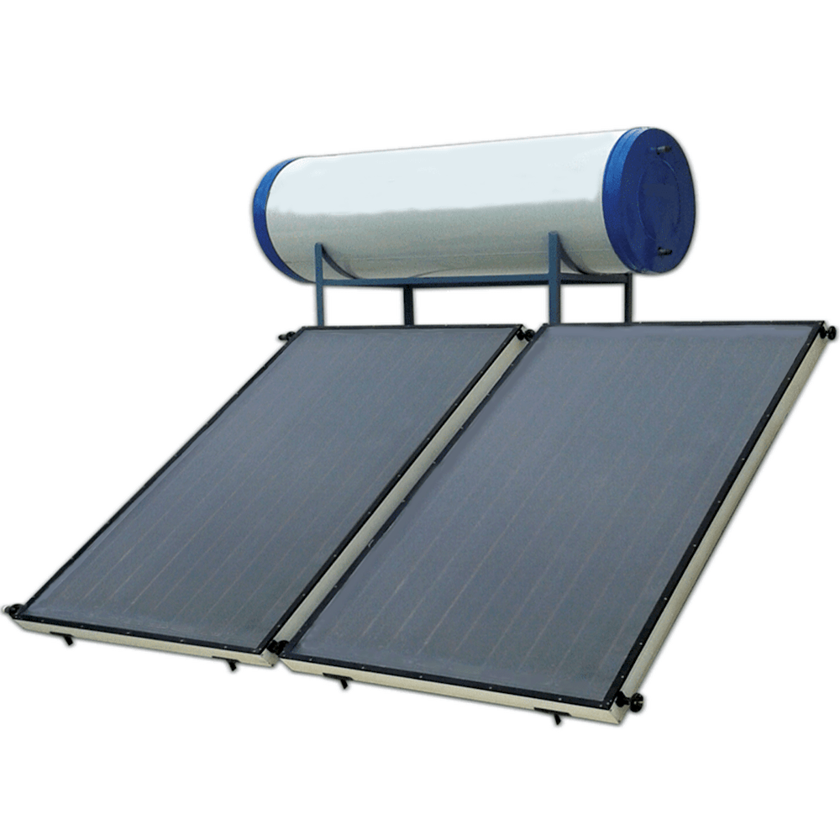
SOLAR WATER HEATERS
BENEFITS
Cost Savings
Reduces electricity or gas bills by using free solar energy for water heating.
Environmental Impact:
Reduces greenhouse gas emissions and reliance on non-renewable energy sources.
Energy Independence:
Deceases reliance on the grid and fossil fuels, which can be particularly beneficial in remote areas.
Increased Property Value:
Solar water heaters can increase the value of your home and may qualify you for incentives and rebates.

Slide 5
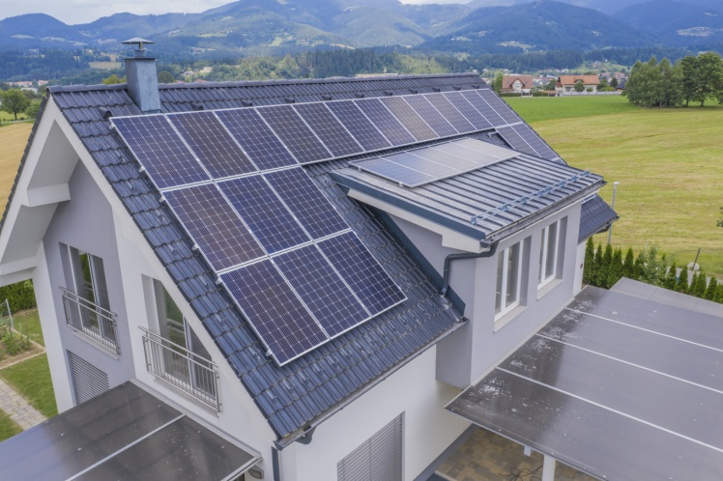
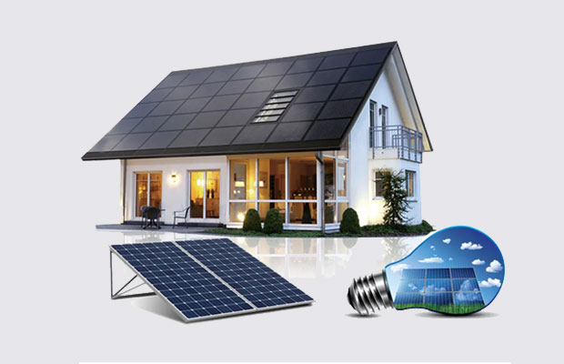
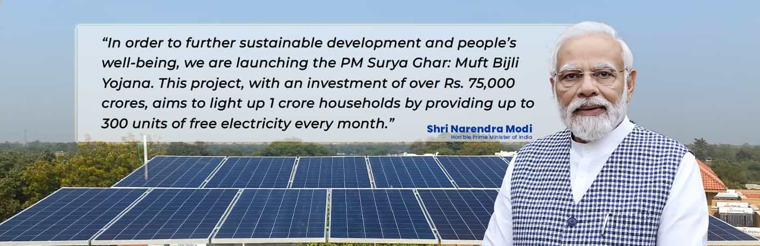
Solar Rooftop (PM Surya Ghar Yojana)
Installing solar panels on a rooftop can offer numerous benefits, both environmental and economic. Here’s a comprehensive look at the advantages:
1 Cost Savings
2 Reduced Electricity Bills.
3 Long-Term Savings.
4 Environmental Impact.
5 Reduced Carbon Footprint.
6 Low Maintenance.
7 Energy Efficiency and Technology.
8 Contribution to Energy Transition.
9 Roof Suitability.
10 Monthly Returns.
Overall, the benefits of installing solar panels on your rooftop make it a compelling option for those looking to reduce energy costs, support sustainability, and contribute to a cleaner environment.

Slide 6

Monthly Returns and ROI
Sanction Load – 5KW Investment around 3 Lakh
Electricity Bill – Rs 3500 X 12 = Rs 42000/-
Installed 5kw Solar Rooftop
Per KW Generates 4 to 5 U/Day
5KW X 4.5U = 20/day X 30D = 675U/month
Usage – 350 units/ month
675u – 350 = 325u Export to HESCOM
325u X 3.79ps = 1231/- it will deposit to your savings Account
ROI will be
Rs 42000 X 5.5Y = 2,31,000+79,200 = 3,10,200/-
ELECTRICITY BILL

Slide 7
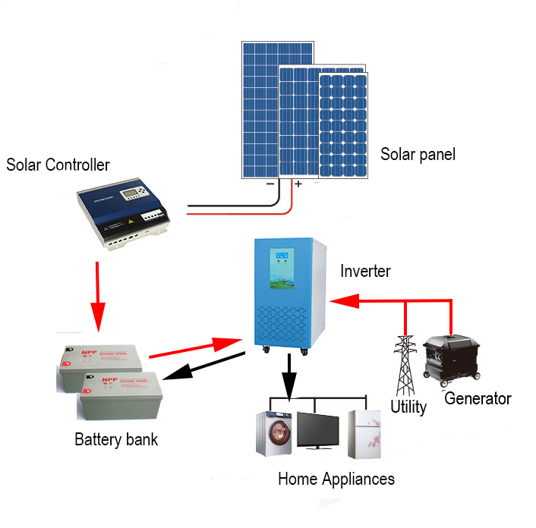
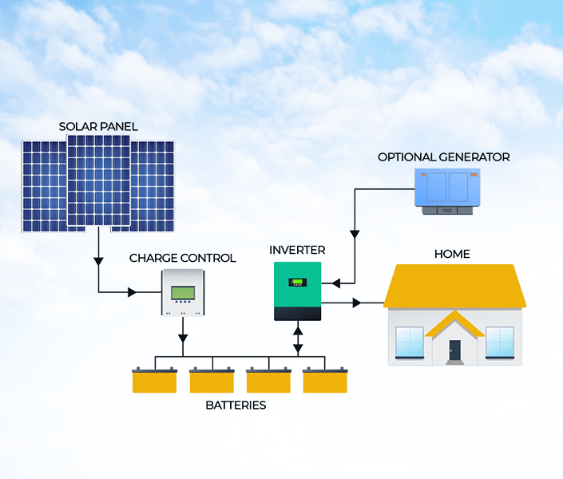
Solar Off Grid Inverters & Batteries
An off-grid solar system consists of solar panels, an off-grid inverter, and batteries. It is designed to function independently of the public electricity grid. Here’s a detailed look at the benefits of using off-grid inverters and batteries in such a system:
Benefits of Off-Grid Inverters
Independence from the Grid
Self-Sufficiency.
Energy Management.
Power Conversion:
Efficiency.
Advanced Features.
Integrated Controllers.
Monitoring and Control.
Customization.
Hybrid Capabilities.

Slide 8

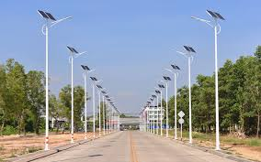

Solar Street Lights
Solar street lights are an innovative and sustainable solution for outdoor lighting, commonly used for street and pathway illumination. They harness solar energy to power LED lights, making them an environmentally friendly and cost-effective choice. Here’s a comprehensive overview of solar street lights, including their features, benefits, and considerations
Types of Solar Street Lights
Integrated Solar Street Lights
All-in-One Design: Combines solar panels, LED lights, and batteries into a single unit. This design is compact and easy to install.
Separate Components
Modular Design: Features separate solar panels, LED lights, and batteries. This allows for more flexibility in installation and maintenance.
Smart Solar Street Lights
Advanced Features: Includes smart technology such as adaptive lighting, remote monitoring, and sensors for motion detection.
In summary, solar street lights offer numerous benefits, including energy efficiency, environmental sustainability, and low operating costs. They are particularly well-suited for areas with abundant sunlight and can enhance safety and security while reducing the dependency on the electrical grid. When considering solar street lights, it's important to evaluate factors such as initial cost, local sunlight availability, and system maintenance to ensure the best fit for your needs.

Slide 9


Solar Water Pumps
Solar water pumps are a sustainable and efficient solution for moving water using solar energy. They are particularly useful for applications in agriculture, rural areas, and remote locations where access to grid power is limited or unavailable. Here’s an overview of solar water pumps, including their features, benefits, and considerations:
Benefits of Solar Water Pumps
Energy Independence Renewable Energy: Solar water pumps use renewable solar energy, reducing reliance on fossil fuels and decreasing energy costs.
Grid Independence: Ideal for remote areas without access to the electrical grid, ensuring a consistent water supply.
Cost Savings Low Operating Costs: After the initial investment, the cost of operating solar water pumps is minimal, as they do not require fuel or electricity from the grid. Reduced Maintenance: Solar pumps have fewer moving parts compared to diesel or gas-powered pumps, leading to lower maintenance costs.
Environmental Impact Reduced Carbon Footprint: Using solar energy reduces greenhouse gas emissions, contributing to a cleaner environment.
Reliable Operation Autonomous Functioning: Solar water pumps operate independently, ensuring a reliable water supply in areas where grid power is unstable or unavailable.
Automatic Operation: Many systems include automatic controls that adjust the pump operation based on solar intensity and water levels.
Flexibility and Versatility Variety of Applications: Suitable for various applications including irrigation, livestock watering, and domestic water supply.
Scalability: Systems can be scaled to meet different water needs by adjusting the size of the solar array or pump.

Slide 10


Contact us
Contact us
Review Us
Thank You

